Slide 1
MIS 7720 #8 Artificial Neural Networks (ANN)

Slide 2
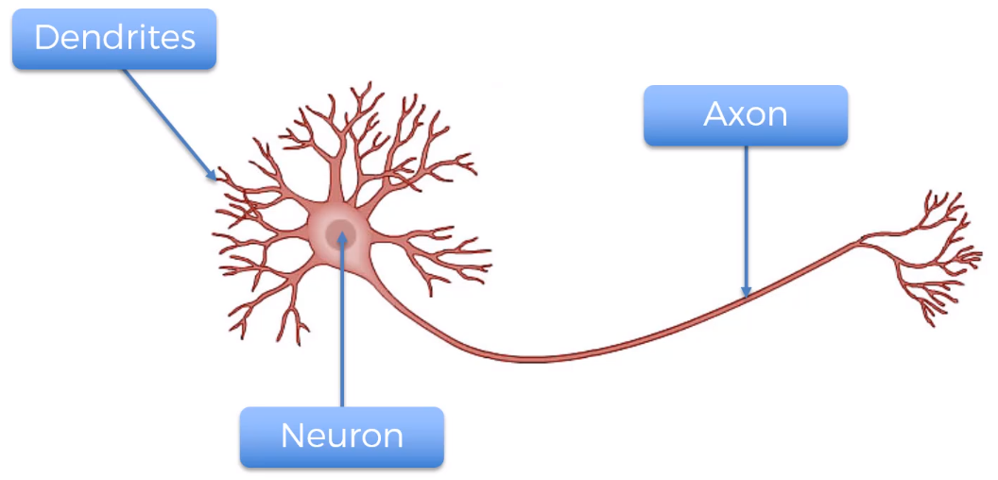
Neuron

Slide 3
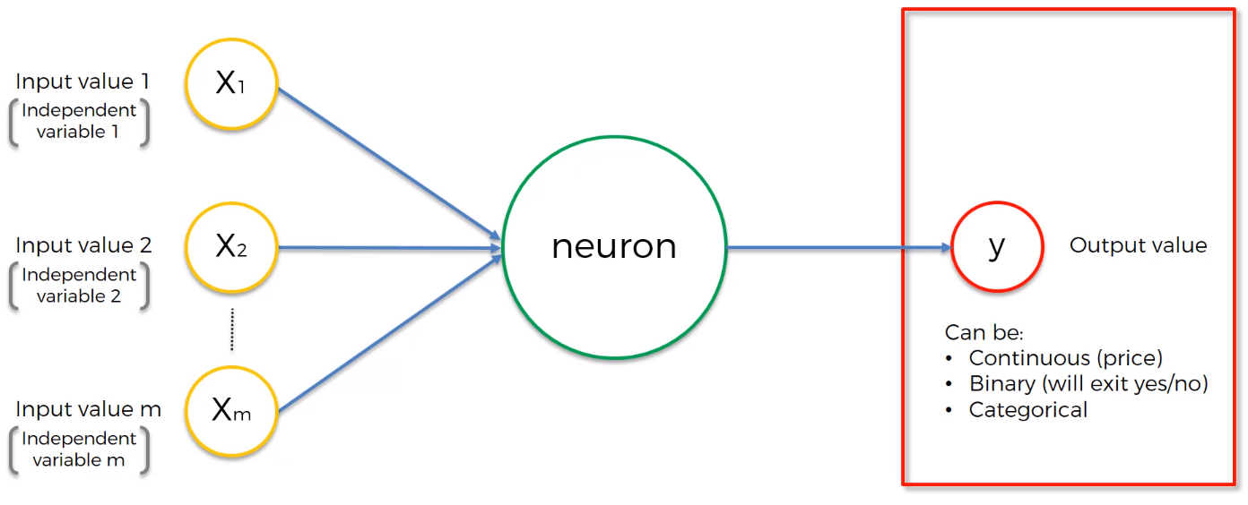
Artificial Neuron
Standardize OR Normalize

Slide 4
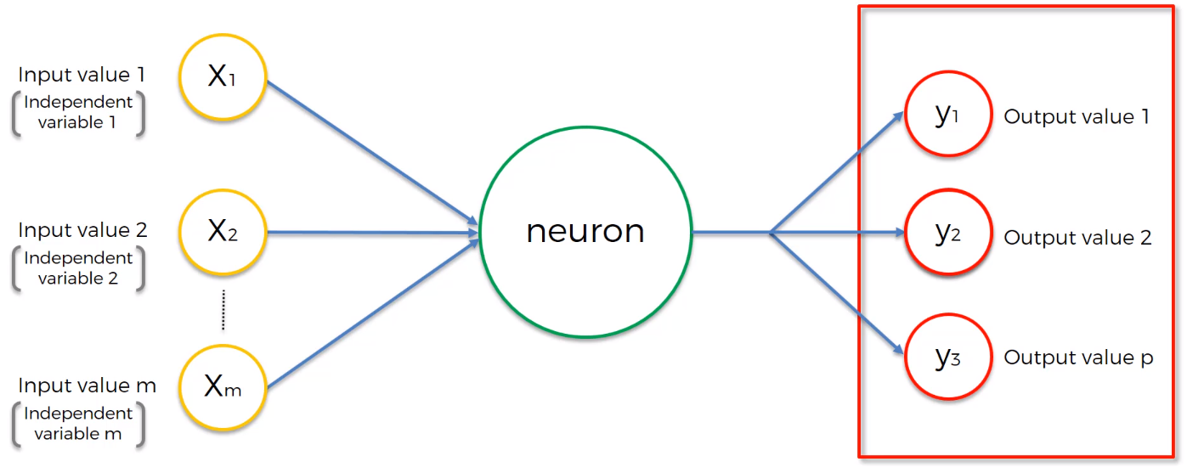
Categorical outcome

Slide 5
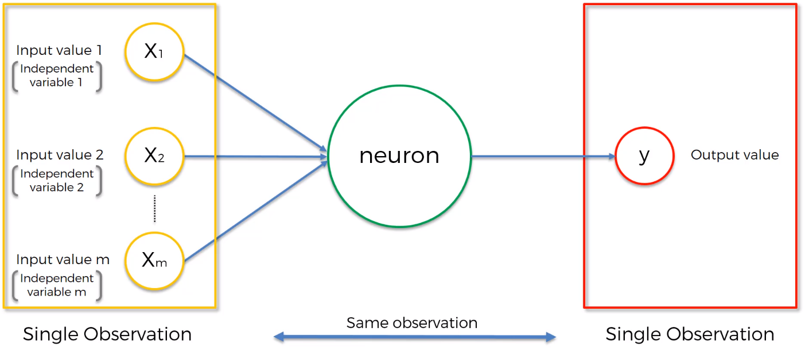
ANN

Slide 6
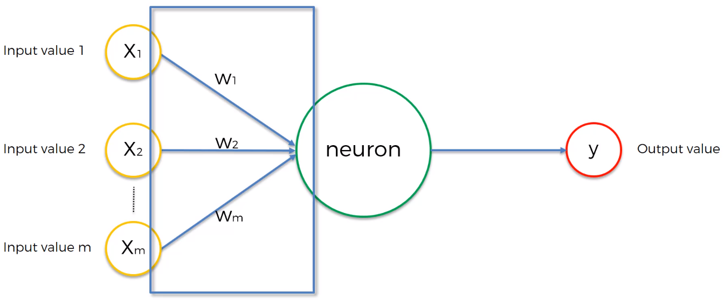
ANN – Weights
ANN learns by adjusting the weights
Back propagation, gradient descent

Slide 7
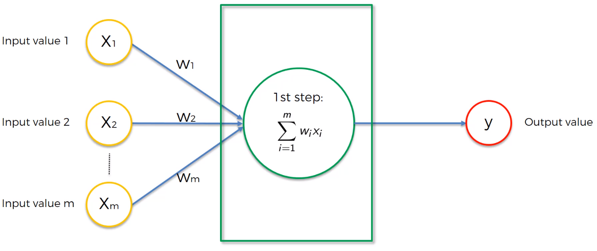
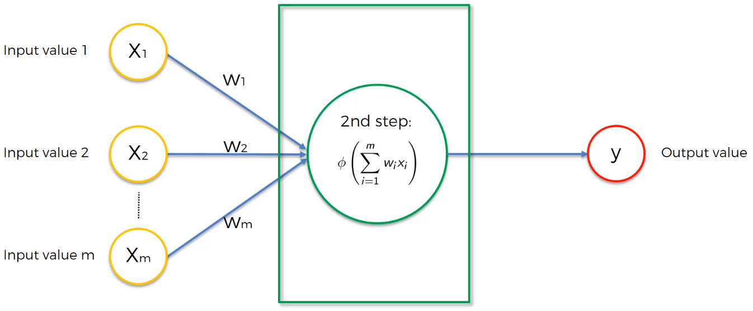
ANN – what does the neuron do?
Notes:
Step1: weighted sum
Step2: activation function → pass OR no pass

Slide 8
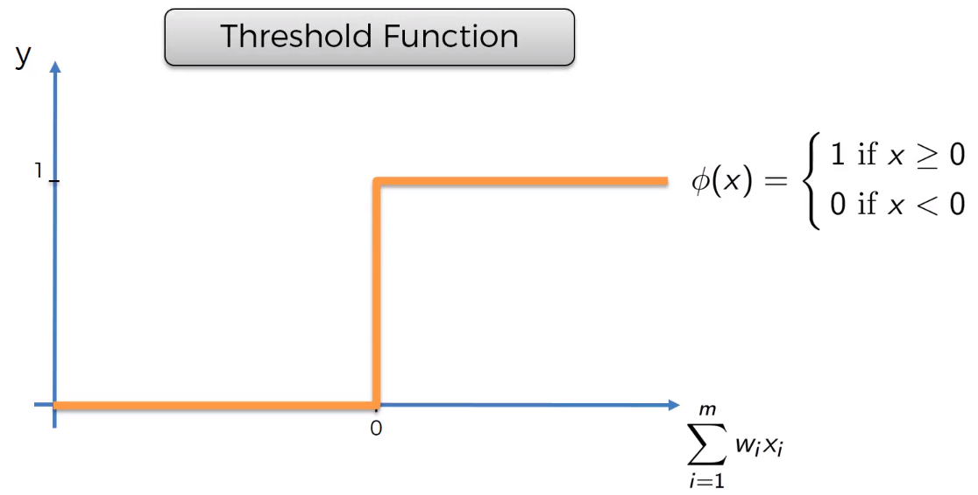
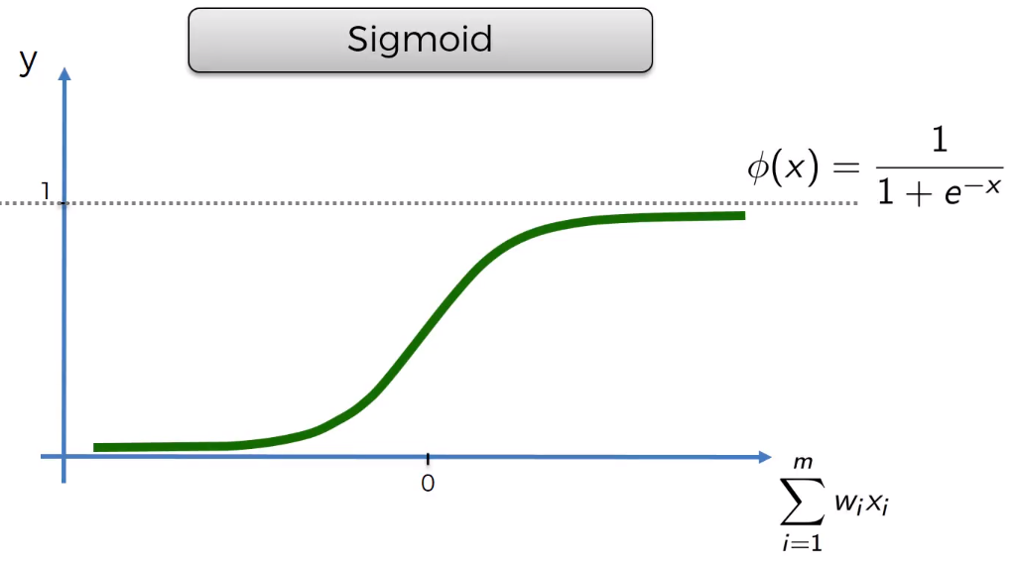
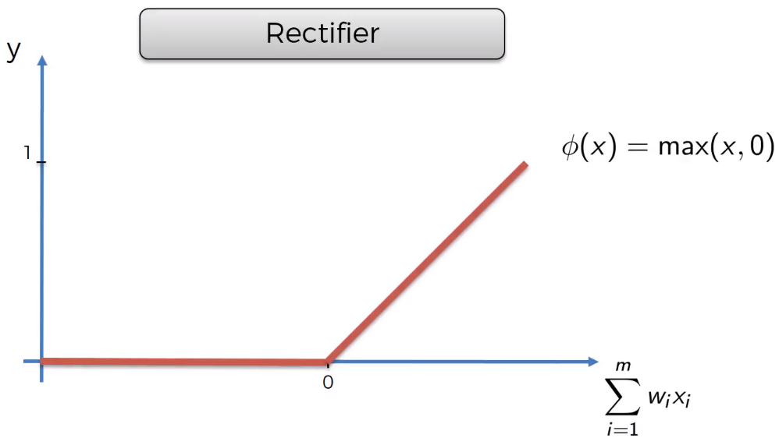
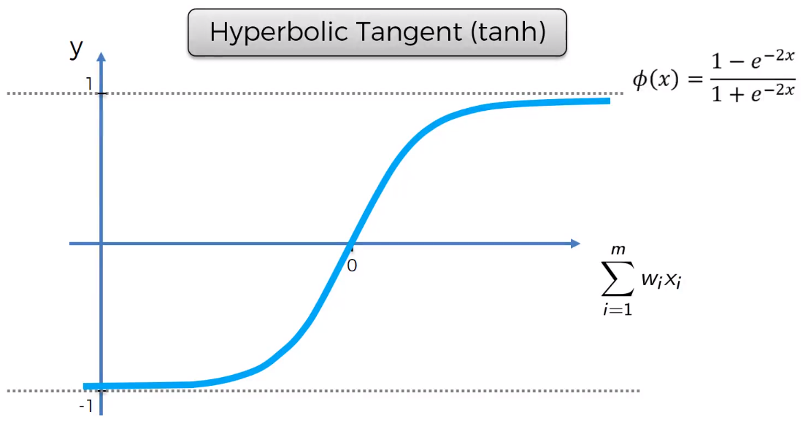
ANN – Activation functions
Notes:
https://en.wikipedia.org/wiki/Activation_function

Slide 9
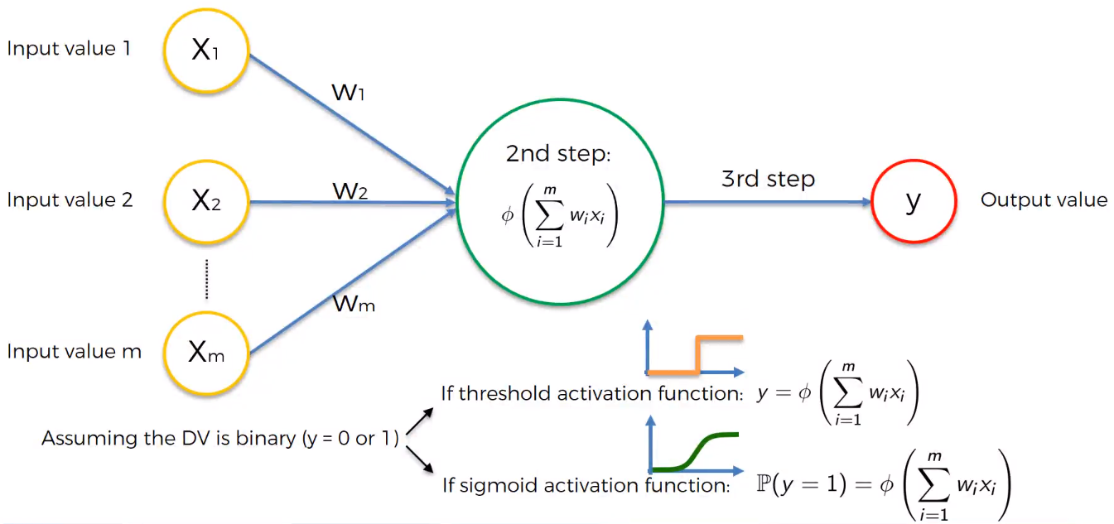
ANN – activation function example

Slide 10
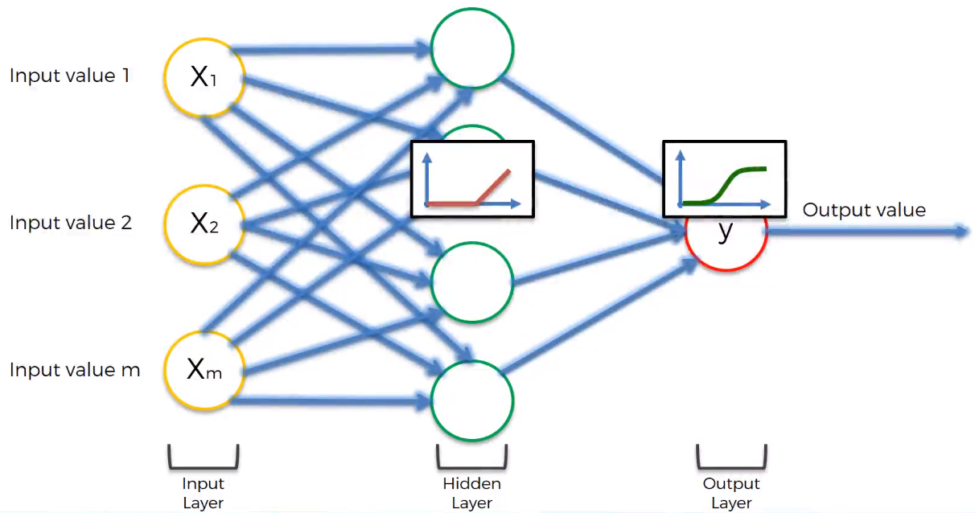
How does a ANN look like?
Notes:
Rectifier activation function in hidden layer
Sigmoid activation for output layer

Slide 11
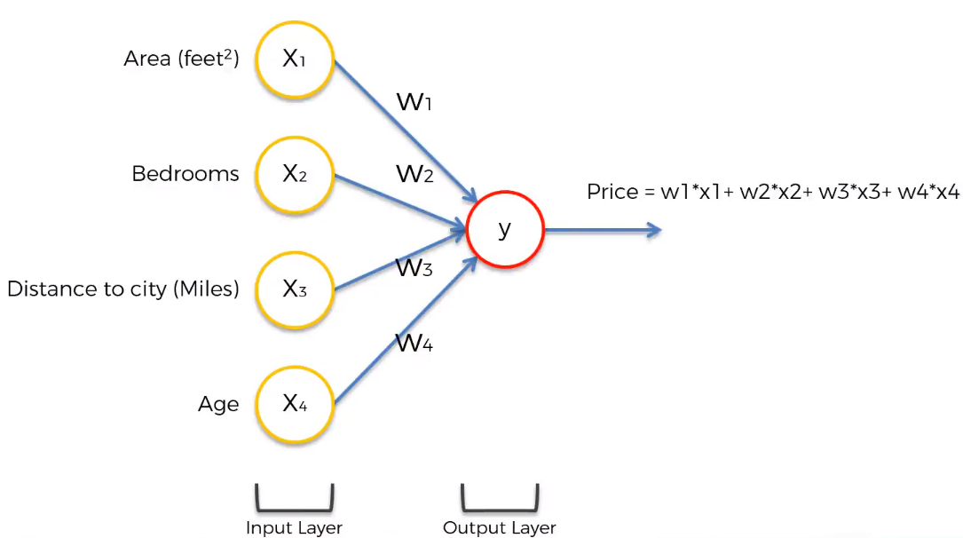
How do ANNs work?
This ANN could do the same as a multivariate regression! (numeric prediction ML technique)

Slide 12
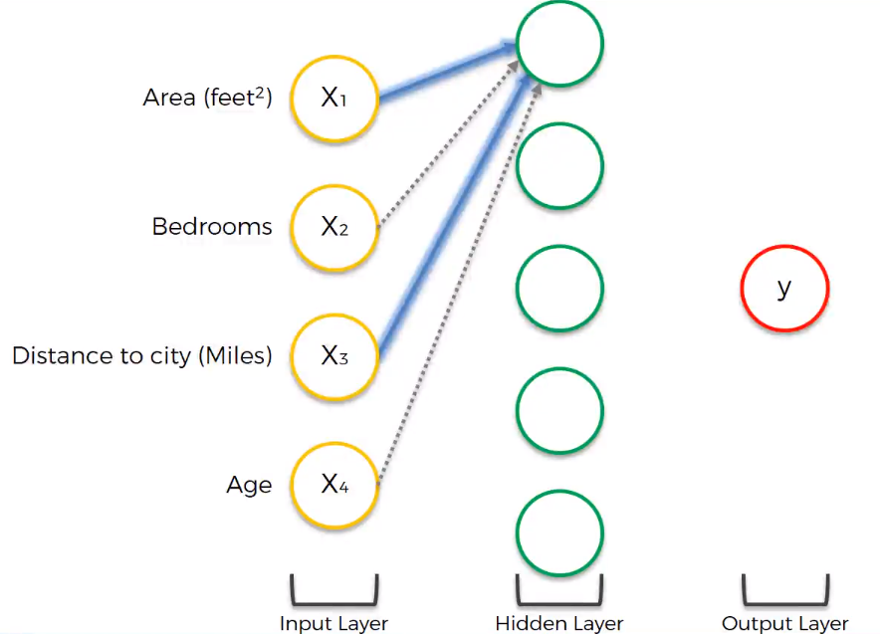
How do ANNs work?
This neuron is picking up certain cases where Area and Distance matter.
E.g., could be houses that are unusually large given their distance from the city, hence bedrooms and age become insignificant.

Slide 13
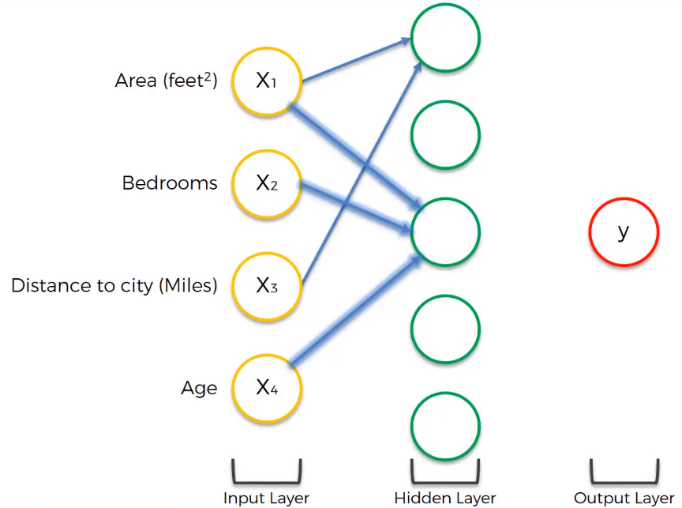
How do ANNs work?
This neuron is becoming more sensitive to certain cases where Area, Bedrooms, and Age matter.

Slide 14
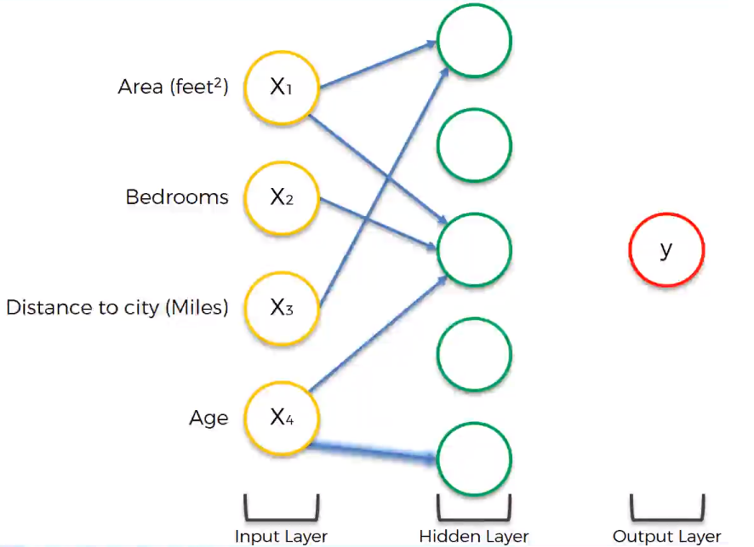
How do ANNs work?
This neuron is more sensitive to certain cases where the Age of the building matters.
E.g., a house that is more than 100 years old and is considered a historic place!
→ A rectifier function would be used in that neuron

Slide 15
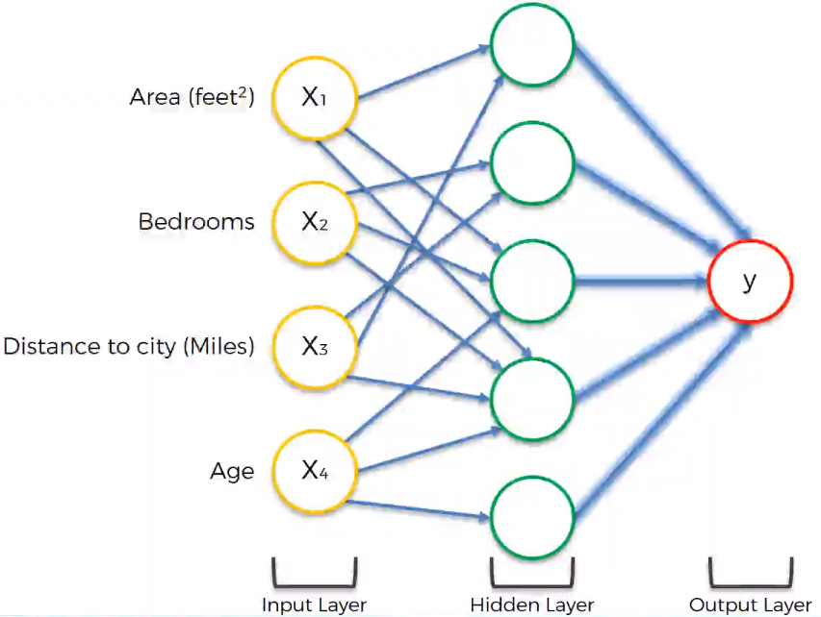
How do ANNs work?
Each neuron is becoming good at picking up cases where different combinations of inputs matter.
That gives it the power to predict Price better than other ML techniques

Slide 16
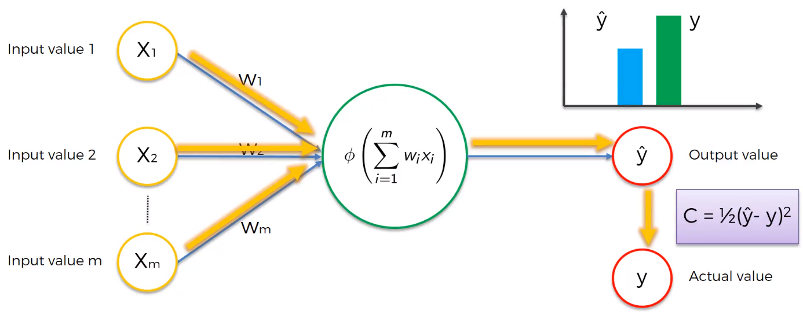
How do ANNs learn? Perceptron
Single layer feed forward neural network = Perceptron
It’s basically a binary classifier
Notes:
Feed forward
Calculate cost

Slide 17
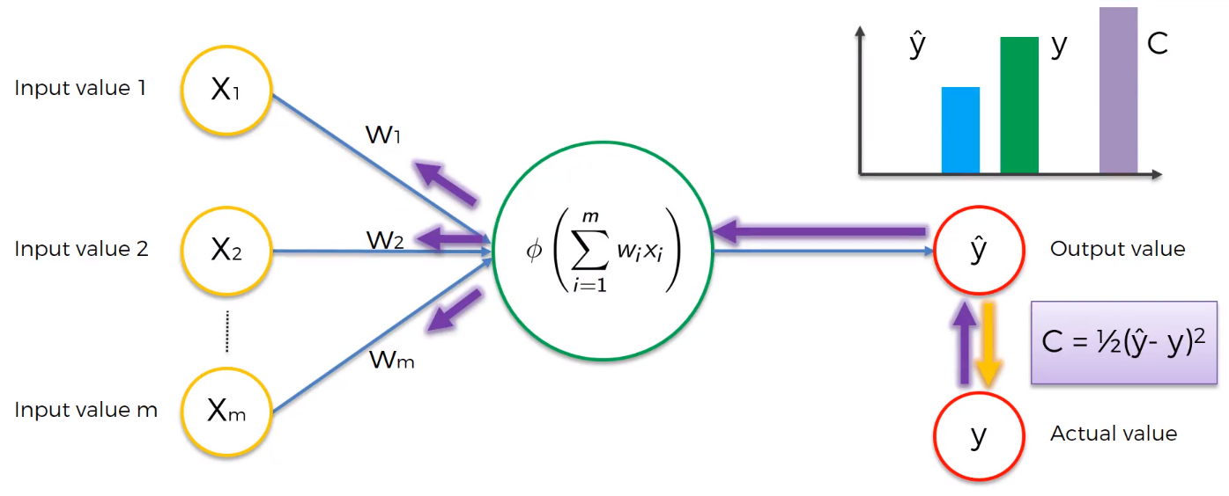
Perceptron
Notes:
Back propagate
Update weights

Slide 18
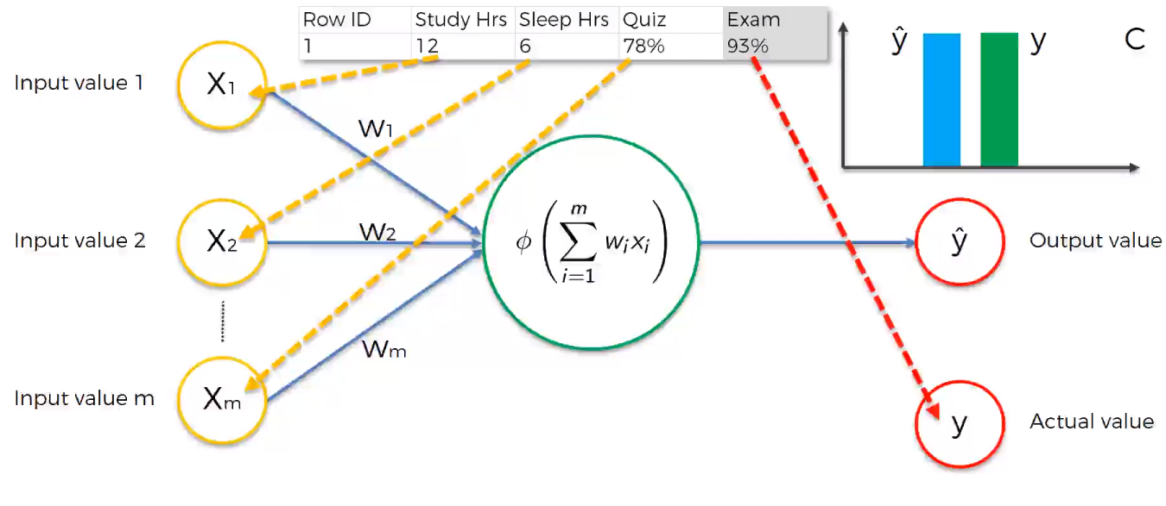
Perceptron

Slide 19
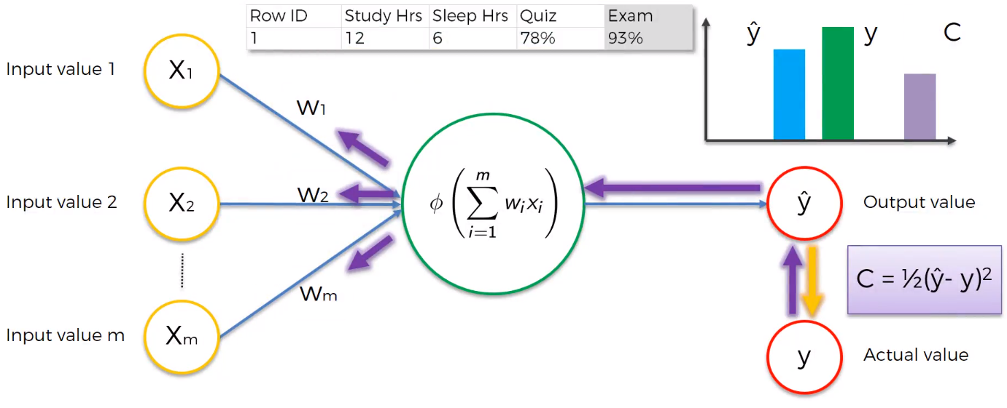
Perceptron

Slide 20
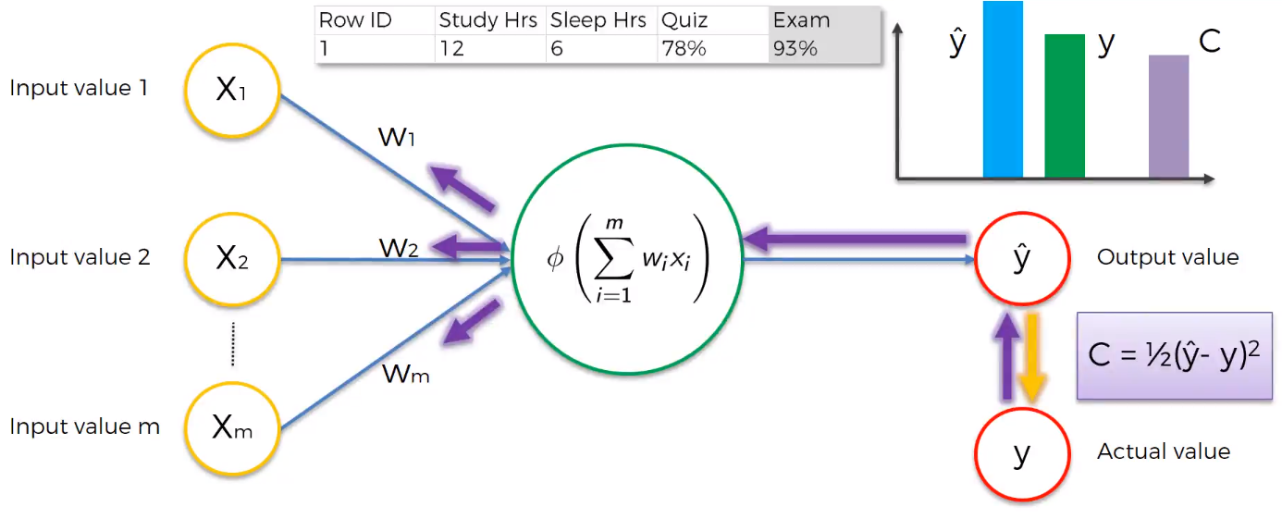
Perceptron

Slide 21
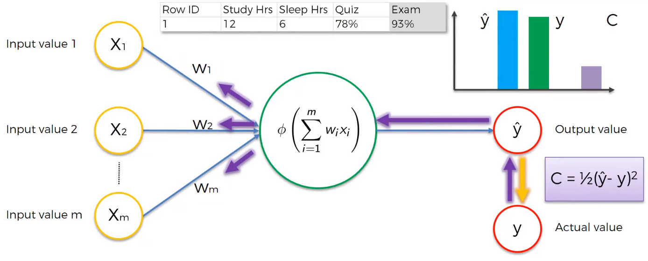
Perceptron

Slide 22
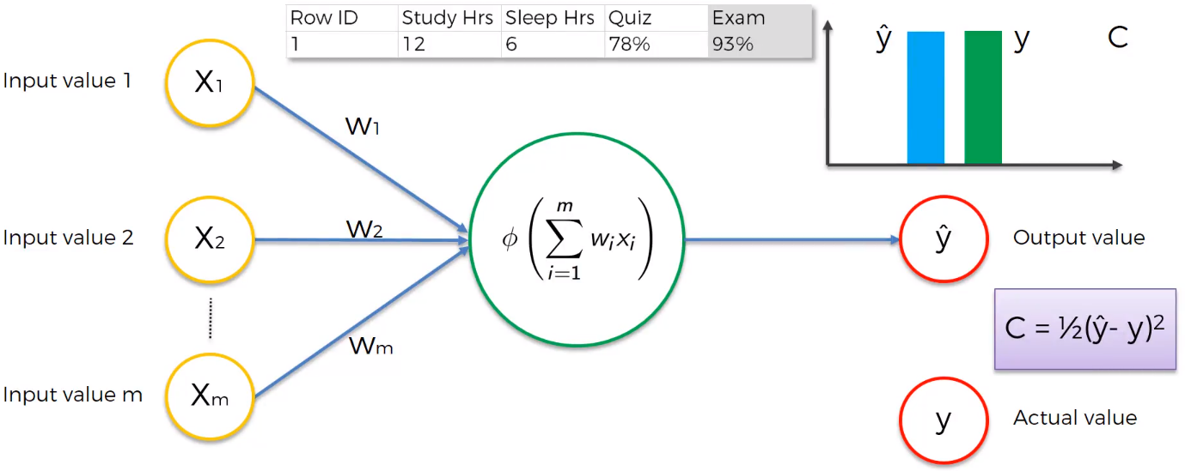
Perceptron

Slide 23
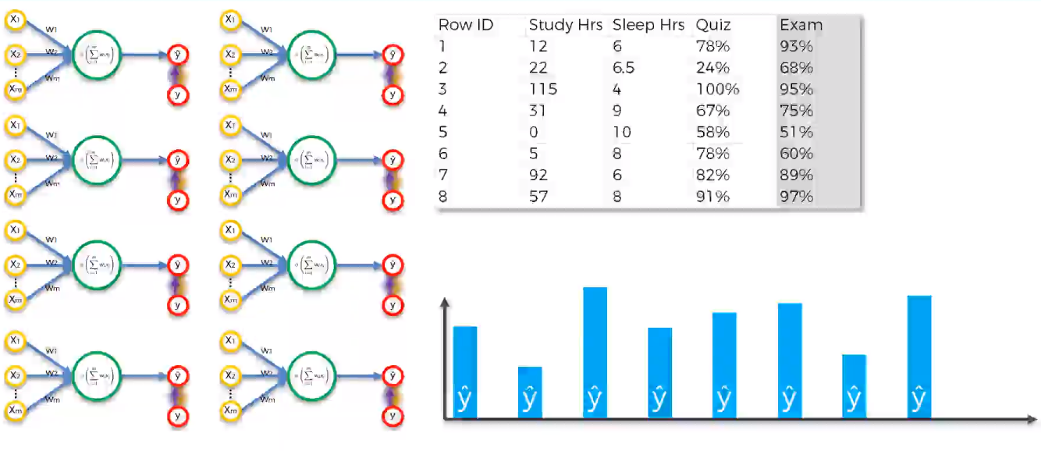
Now let’s do it with multiple rows…

Slide 24
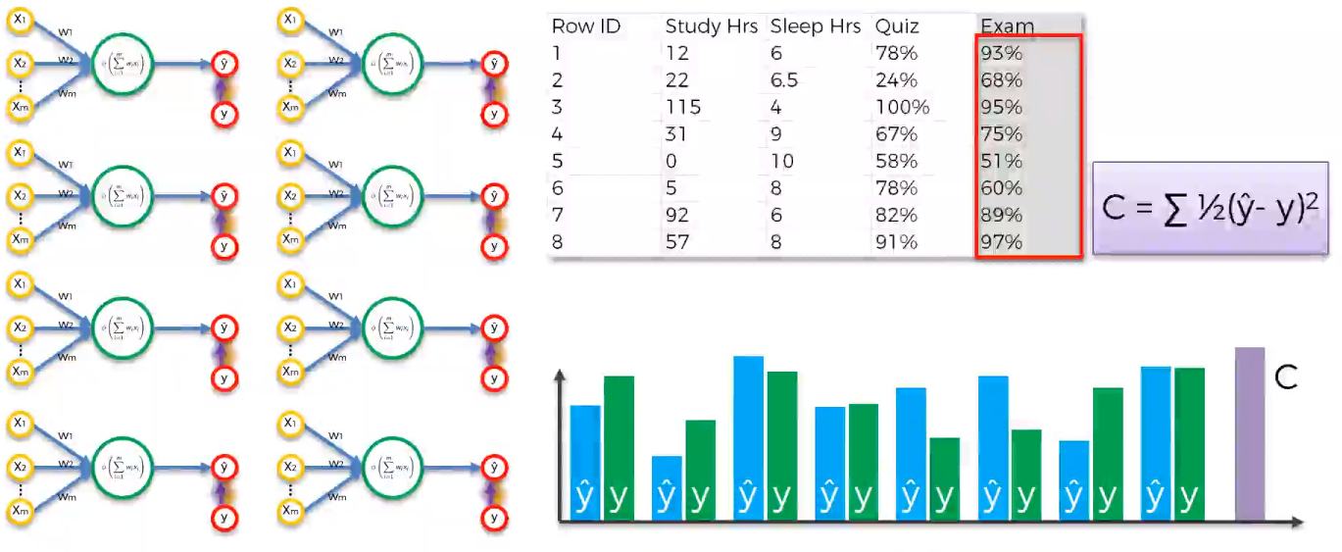
Epoch 1 – feed forward

Slide 25
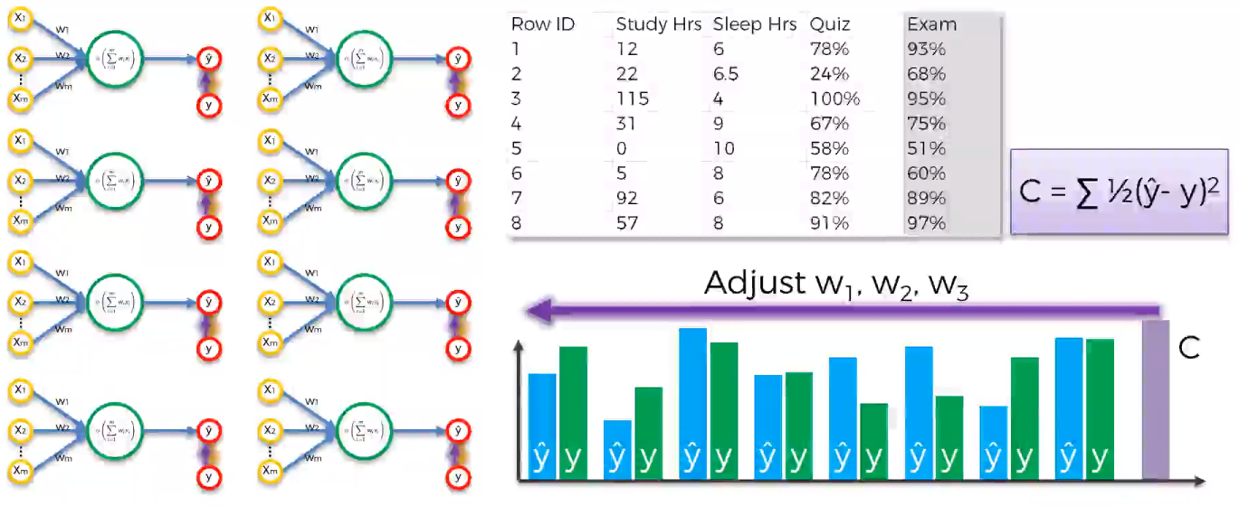
Epoch 1 – backpropagate, update weights
Notes:
During backpropagation all weights are updated simultaneously

Slide 26
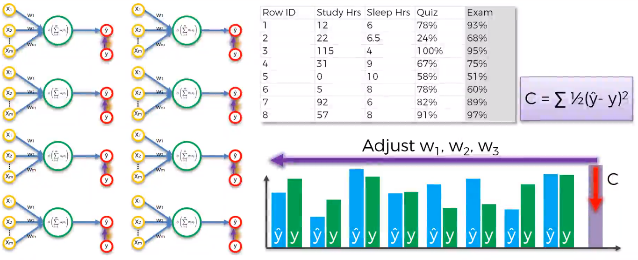
Epochs continue till cost goes down
Notes:
Continues till cost function reaches a set threshold (close to zero).

Slide 27
Training the ANN =
minimizing the cost function by adjusting the weights

Slide 28
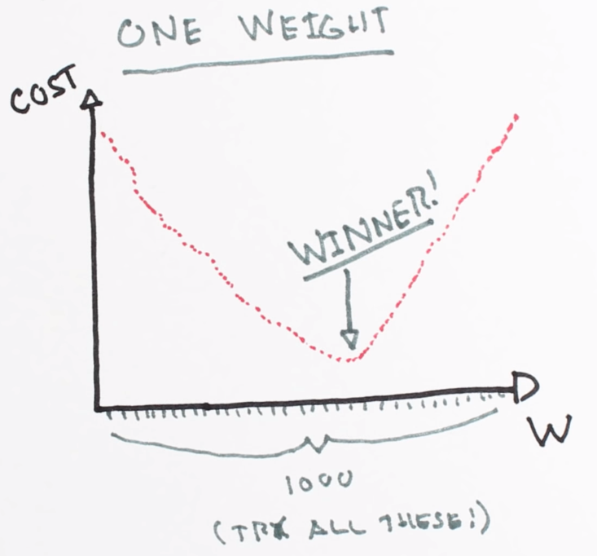
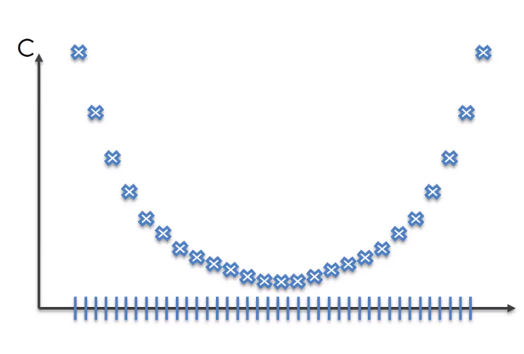
How are the weights adjusted?
Goal: adjust weights to minimize cost
Brutefore ?
For one weight, W
It can work
But we have more weights…
Curse of dimensionality

Slide 29
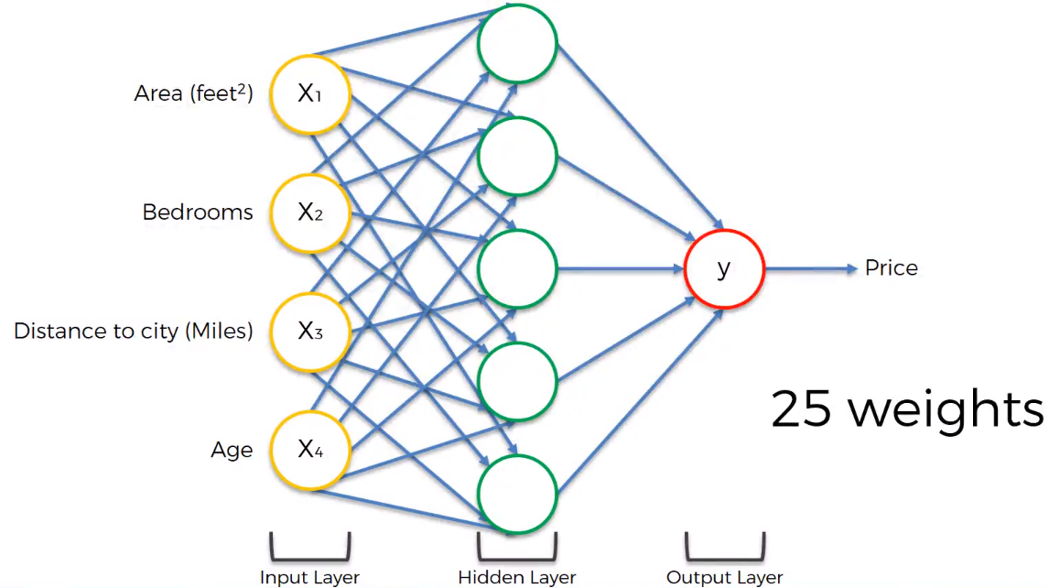
Curse of dimensionality
1000²⁵ = 10⁷⁵ combinations!!!
Impossible!!
Notes:
With 1000 possible weights to try for each weight…

Slide 30
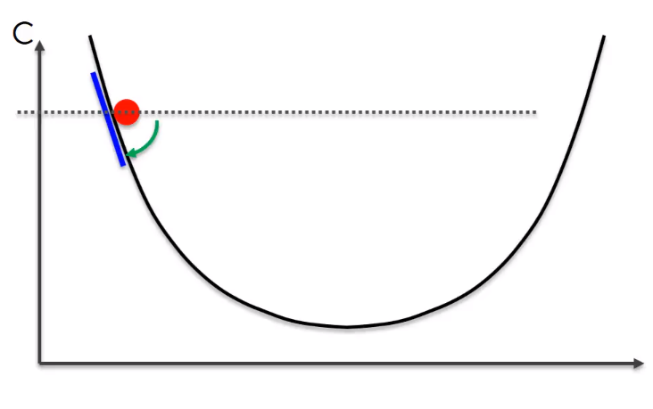
Gradient Descent
Take the gradient

Slide 31
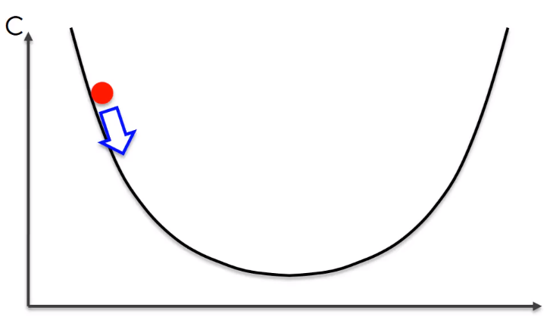
Gradient Descent
Take the gradient
Slope is negative → go right

Slide 32
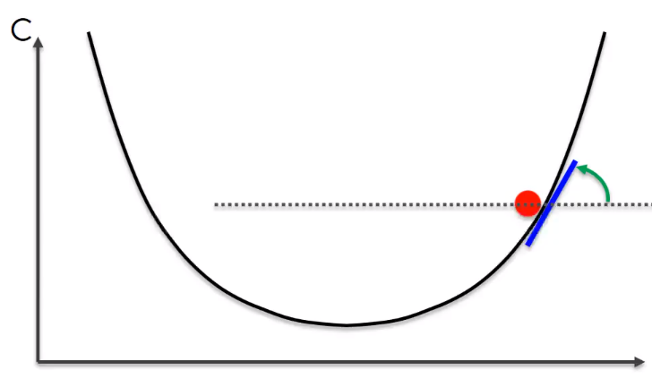
Gradient Descent
Take the gradient
Slope is negative → go right
Take the gradient

Slide 33
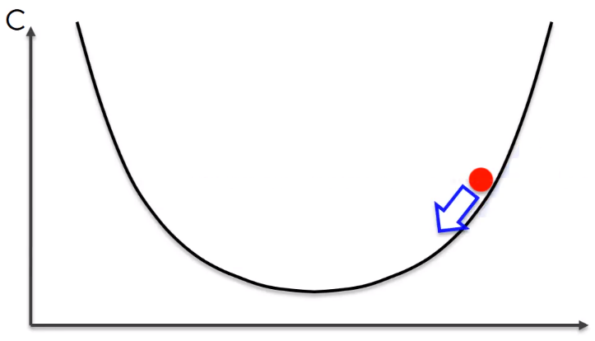
Gradient Descent
Take the gradient
Slope is negative → go right
Take the gradient
Slope is positive → go left

Slide 34
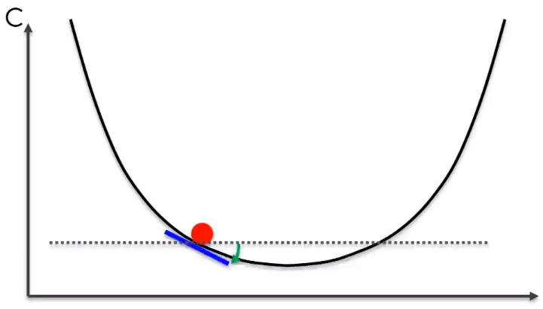
Gradient Descent
Take the gradient
Slope is negative → go right
Take the gradient
Slope is positive → go left
Take the gradient
Slope is negative → go right

Slide 35
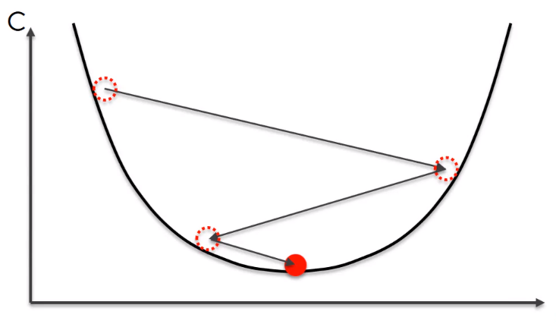
Gradient Descent
Take the gradient
Slope is negative → go right
Take the gradient
Slope is positive → go left
Take the gradient
Slope is negative → go right
Take the gradient
Slope is zero → DONE

Slide 36
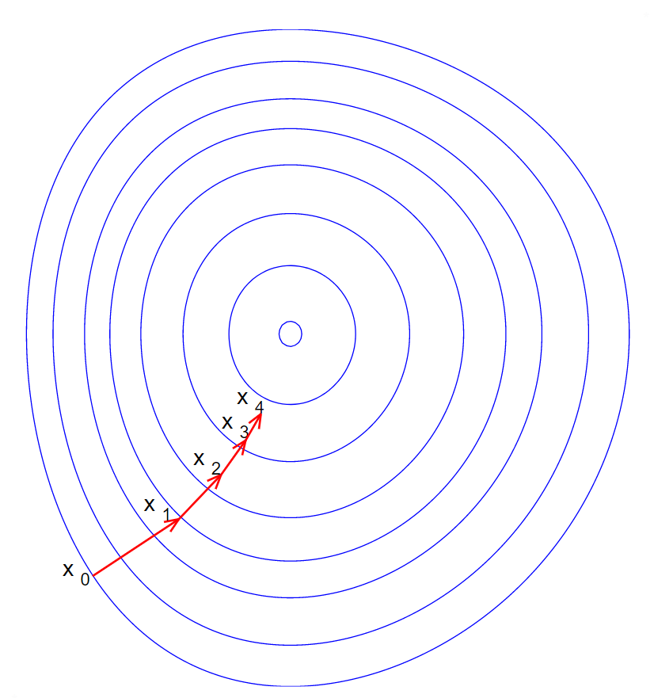
Gradient Descent – 2D

Slide 37
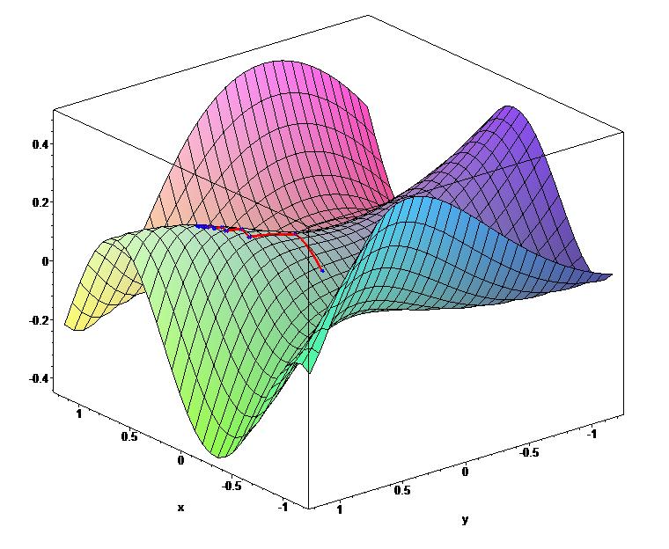
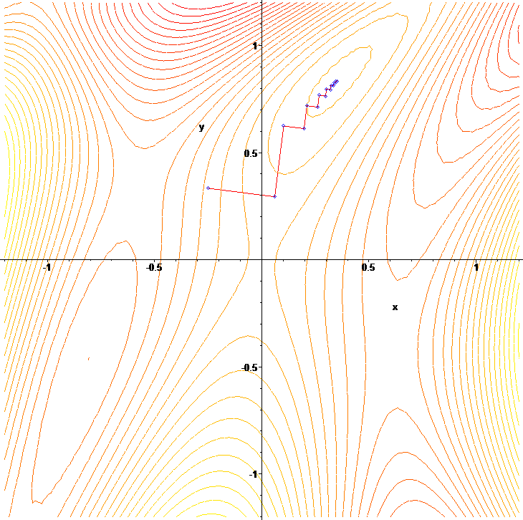
Gradient Descent – 3D

Slide 38
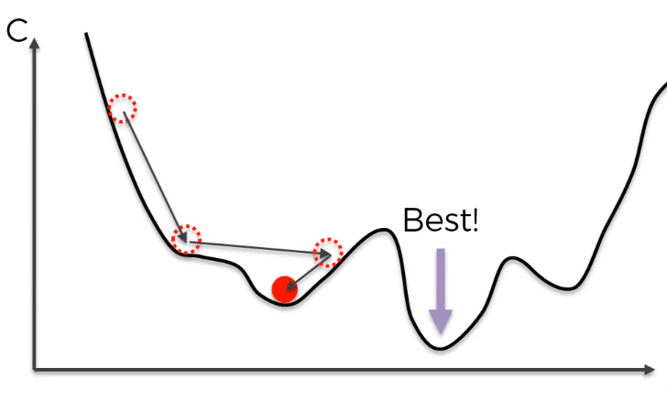
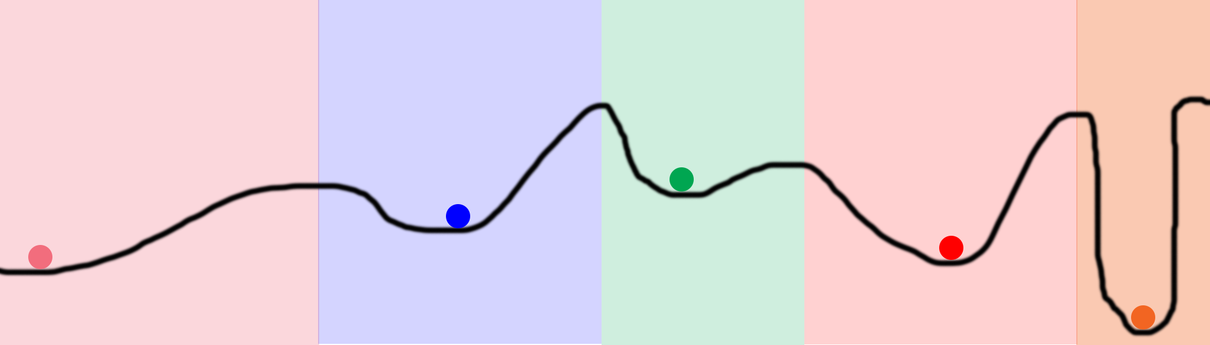
Gradient Descent issues
Learning rate determines length of the steps
Too high → cost increases instead of decreasing
Too low → slow learning (may take for ever to converge)
Requires our cost function to be convex
Otherwise, may fall into local optima!

Slide 39
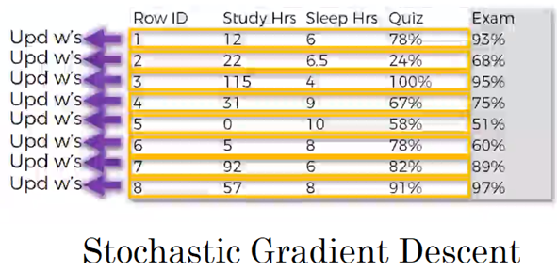
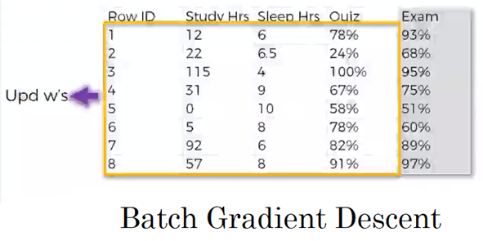
Stochastic Gradient Descent
Helps avoid the local optima problem
Is faster (quicker learning)
Notes:
Minibatch gradient descent is another approach in between the two above.

Slide 40
Training an ANN – overview
Randomly initialize the weights to small numbers close to 0.
Input the first observation of the dataset at the input layer, each feature in one node.
Forward-propagation: the neurons are activated (from left to right) in a way that the impact of each neuron’s activation is limited by the weights. Propagate the activations until we get to the predicted result.
Compare the predicted result to the actual result, calculate the error (Cost).
Back-propagation: the error is back-propagated (from right to left). Update the weights according to how much they are responsible for the error. The learning rate decides by how much we update the weights.
Repeat steps 1 to 5 and update the weights after each observation (stochastic Grad Desc)
Repeat steps 1 to 5 but update the weights only after a batch of observations (batch Grad Desc)
An epoch is the whole training set passing through the ANN. Redo more epochs.

Slide 41
Let’s play with a Neural Network
Visualized interactive simulation
https://playground.tensorflow.org

Slide 42
Some videos to review ANNs
Uses python to solve a regression problem with ANN
https://www.youtube.com/watch?v=bxe2T-V8XRs&list=PLiaHhY2iBX9hdHaRr6b7XevZtgZRa1PoU
Data & Architecture
Forward propagation
Gradient descent
Backpropagation
Notes:
UPDATE!

Slide 43
More Resources (optional)
Various cost functions and their applications
https://stats.stackexchange.com/questions/154879/a-list-of-cost-functions-used-in-neural-networks-alongside-applications
Backpropagation algorithm (good ebook)
http://neuralnetworksanddeeplearning.com/chap2.html
Efficient Backprop
http://yann.lecun.com/exdb/publis/pdf/lecun-98b.pdf
Deep Sparse Rectifier Neural Networks
http://proceedings.mlr.press/v15/glorot11a/glorot11a.pdf

